Slide 1
medCafe
Gail Hamilton and Jeff C. Hoyt
703-983-7855 • ghamilton@mitre.org
703-983-6241 • jchoyt@mitre.org
MITRE Internal Information
For Limited External Release

Slide 2
Overview
We want to demonstrate ways to give
caregivers more time to do what matters most
Showcase CCoD¹ principles to provide relevant data quickly
Provide components to streamline their current workflow
¹Composable Capability on Demand
Notes:
In our MIP we hope to provide a means to demonstrate to the clinicians a way to access to the most relevant data when they need it.
This will help the caregivers to spend more time providing effective care.
We plan to do this through using CCoD principles to provide relevant and timely information to the clinician.
And are provid a small number of compelling components,to be used within this framework to help streamline the physicians current workflow.

Slide 3
How do we do it?
Providing an extensible User Defined Interface for clinicians to allow them to be more efficient
Create composable record view
Templates
Providing a way for physicians to process the non categorized “Outside records”
Work closely with SMEs
Christian Donahue, M.D. (Durham Medical Center, NC)
National Primary Care Redesign Workgroup
Durham VA Systems Redesign Steering Committee
Durham VA Primary Care Redesign Committee
Notes:
We planned to
By tackling the problems by applying Composable capabilty on demand principles to the Healthcare domain.
The first part is to provide a flexible, easily extensible User defined interface.
The second is to provide a way for physicians to deal with the cumbersome and time consuming “Outside records”. By providing a means of categorizing the pdf data through text extraction.

Slide 4
Key Deliverable: FY10 Prototype
User Defined Interface
Categorize images outside records
MyInterface
Customizable to clinician’s requirements
Templates
Components
Coverflow interface to review images
Filter criteria
‘See’ what other components were used to review patient’s history
Add new SME identified components (e.g. Timeline)
Notes:
These are the key deliverables that we expect to deliver.
We already have the framewrk in place for the User Defined Interface.
And are working on adding more components to this interface.
We plan to provide a customizable interface that the clinician can save and return to.
As well as providing templates for easy data retrieval.

Slide 5
Project Timeline
Total cost/duration: 1 yr/$325,000
Notes:
Have moved the 2nd quarter goal of developing a prototype composable framework to 1st goal. Moved the 1st quarter goal of categorization of pdf to second quarter.
Two goals were parallel and not dependant upon one another. So no impact on longer term goals.

Slide 6
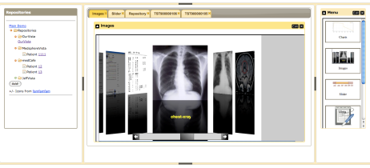





medCafe Architecture
Composable Framework
RESTful Web Services
Tomcat Web server
T
Tabs
Coverflow
Date Slider
Image Viewers
Charts
openVista
AJAX
JAVA/ J2EE
Additional
Data servers
medCafe Interface
Health-data server
Notes:
This shows the architecture of the framework that we have built.
We have two distinct pieces that make up the medcafe composable framework.

Slide 7
medCafe Front End Architecture
VISUAL
WIDGETS
Coverflow
Image Viewer
Date Slider
Charts
Tables
TreeView
Image Zoom
…

Slide 8
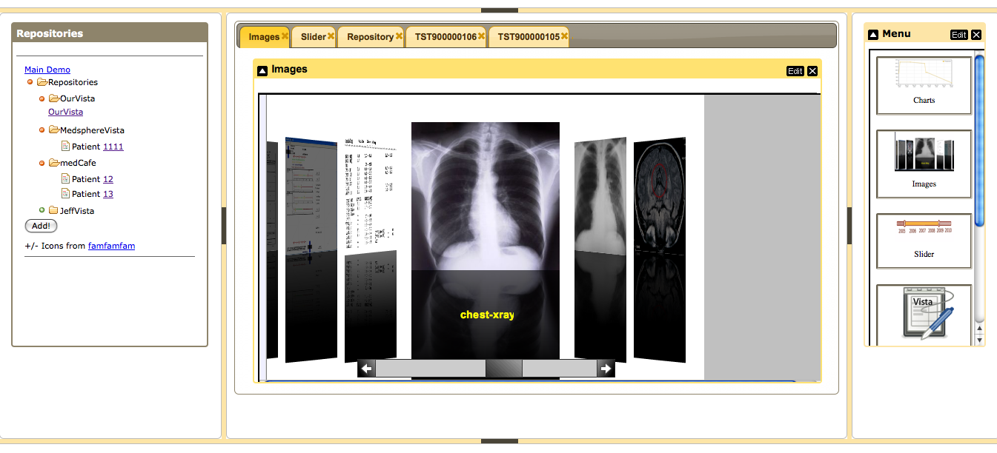
medCafe Interface
Notes:
Framework overview:
5 major panes, North, South, etc,..
Can hide, show each pane.
Each pane can have multiple objects within it, such as tabs, widgets, sliders,treeviews etc,..

Slide 9
Health-data Server Architecture
RESTful Web Services
Tomcat Web server
T
openVista
JAVA/ J2EE
Additional
Data servers
Health-data server

Slide 10
Next Steps (from last quarter)
Widget Development
Timeline showing events, office visits etc,
Clickable to bring up associated chart
Text editor
Copy text between widgets
Filter on categories
Chart enhancements (thresholding etc.)
Overall
Add additional data-sources
PDF Text extraction
Categorize the data
Save state of patient data so physician can return on login
Security – login page

Slide 11
Development Milestones
Widget Development
Timeline showing events, office visits etc,
Clickable to bring up associated chart/ Xray
Text editor with templates
Copy text between widgets
Filter on categories
Medication List
Allergy List

Slide 12
Development Milestones (cont.)
Overall
Save state of patient data so physician can return on login
Security – login page
Patient search / selector
Scheduling
Drag and drop functionality
Introductory page directing user to select patient
Recent patient list
Multiple Repositories
Coversheet Header
Add additional data-sources: hData
PDF Text extraction of discharge summaries
Categorizing the data
Tooltip for more details
Fuzzy matching on categories (e.g. Smoker/ Smoking)

Slide 13
Discussions Dr. Donohue
Image functionality
Categorize and filter
Annotations, and share annotations
Highlight action
Tag documents with keywords and share tags
Patient Coversheet
Vital signs
Medications List
Allergies
Alerts
Past Medical History. Personal and Family (prioritized)
Social History (Physician Entered)
Patient Photo
Future Appointments

Slide 14
Discussions Dr. Donohue (cont.)
Import data into notes
Allow for automated importation of medications list into notes
Allow other users to access notes (same mechanism as for image tagging / annotation)
Use cases
New patient
Demonstrate how to get data into system for new patient
How to access outside records
Complex Patient
Patient with long history, many complications, medications (with possible interactions, lots of Xrays)
Demonstrate workflow on how to manage this patient
Simple Healthy Patient
Show more proactive care
Preventative Health “clinical reminders”
Show case annotations

Slide 15
Discussions Dr. Donohue (cont.)
Integration of categorized discharge summaries
Other modalities
Play Video
Sound
Voice
Echo cardiogram
Electronic Stethoscope
Transcription

Slide 16
Plan for Next Quarter
Focus on areas identified by Dr. Donohue
Image functionality
Coversheet
Use cases
Data sharing between users
Integration of categorized discharge summaries with thumbnails.
Data entry through iPad (Patient History, details, etc,..)
Retool for iPad.
Templates.
Other modalities. Voice, speech to text. Allow for sound files.
Identify transition opportunities
VA 13 Greatest Challenges
https://www.fbo.gov/index?s=opportunity&mode=form&id=caddaf60d5df4db390e91c4ddc690842&tab=core&_cview=0

Slide 17
Other issues
VA Direction
Primary care change from current retroactive model to more proactive
E.g. Find any patient with bad cholesterol (search ‘Lipitor’) and send automated newsletter.
Patient Centric involving teams collaborating example: http://myhealth.va.gov
Collaboration through daily conferences with specialists
Transition PI
New hire: Mary Greer
HIMSS 11 Abstract
iPad
Demonstrated to Harrold Jeff and TAC group in New Jersey. Response was very positive.

Slide 18
Collaborations
Meeting with Christian Donahue April 30th.
Continue working meetings with him
Feedback at http://mitrepedia.mitre.org/index.php/MedCafe
LAIKA (Andy Gregorowicz, existing work)
Provide data, hData
Automating Fact Extraction from Medical Records, (Cheryl Clark, proposed MSR)
Medical fact extraction to enhance “outside record” categorization
Security: Enforceable Specification of Policy (Peter Mork)
Using OpenVista instance
Multimodal Medical Data Capture and Representation (Qian Hu, existing MSR)
Speech to text capability
Notes:
We have been actively collaborating with both Andy Gregorowicz for hData.
And Cheryl Clark. Who have supplied us with pdfs of discahrge papers.
Are not yet ready to engage with Qian fpr Speech to text facility. Expect that this will happen 2nd to 3rd quarter.

Slide 19
Demo
For live demo:
http://medcafe:8081/medcafe
Notes:
We have been actively collaborating with both Andy Gregorowicz for hData.
And Cheryl Clark. Who have supplied us with pdfs of discahrge papers.
Are not yet ready to engage with Qian fpr Speech to text facility. Expect that this will happen 2nd to 3rd quarter.

Slide 20
Impact If Successful
Demonstrate ways to give
caregivers more time to do what matters most.

Slide 21
Thank you!

Slide 22
medCafe Continuation Plan
Original plan
Integrate with healthLab
Harden and stabilize the prototype from FY10.
This year’s efforts are focused on producing novel ways to interact with medical data. This system is of prototype quality, and must be stabilized for production use.
If possible, create adapters to the EMR chosen when hClinic opens.
Enhance medCafe through an iterative, agile process, based on feedback from physicians working with hClinic .
Once the hClinic initial patient base and key workflows are identified, create standard templates for those workflows.
Evaluate the extent to which Patient OS and medCafe meets the information needs of hClinic physicians and patients based on the results of user satisfaction surveys.
Notes:
We have been actively collaborating with both Andy Gregorowicz for hData.
And Cheryl Clark. Who have supplied us with pdfs of discahrge papers.
Are not yet ready to engage with Qian fpr Speech to text facility. Expect that this will happen 2nd to 3rd quarter.

Slide 23
medCafe Continuation Plan
Revised plan
Integrate with ESP + DRA
Harden and stabilize the prototype from FY10.
This year’s efforts are focused on producing novel ways to interact with medical data. This system is of prototype quality, and must be stabilized for production use.
Create adapters to other HL7 standards
Enhance medCafe through an iterative, agile process, based on feedback from physicians working with MITRE
Using feedback from physicians create standard templates for those workflows.
Evaluate the extent to which medCafe meets the information needs of physicians based on the results of user satisfaction surveys.
Clinician satisfaction
Speed of data retrieval
Comparison of time to complete common tasks with standard EHR Patient OS
Completeness of services provided, by comparing the percentage of tasks completed against a recommended checklist for the diagnosis. (For example asthma has a list of 70 recommended tasks.) And we will compare the use of Patient OS vs. our system against how comprehensive the treatments were according to the Standard of Care criteria.
Notes:
We have been actively collaborating with both Andy Gregorowicz for hData.
And Cheryl Clark. Who have supplied us with pdfs of discahrge papers.
Are not yet ready to engage with Qian fpr Speech to text facility. Expect that this will happen 2nd to 3rd quarter.

Slide 24
medCafe & ESP+DRA
Java* + Metadata
Metadata
medCafe UI
medCafe
wrapper
CDB
Java
XACML
Resu l tSe t
SQL+XACML
Record System
PEP
XML
SQL

Slide 25
medCafe Continuation Plan (cont.)
Revised plan (cont.)
With change in direction of VA:
Proactive
Show all patients that use Lipitor –(high cholesterol), and send news letter
Patient-centric
Emphasis changed from patient one on one appointments to
Team based treatment
Other forms of interaction with patient: email, phone, newsletters
Collaborative meetings involving specialists
Patient access to own health records
Notes:
We have been actively collaborating with both Andy Gregorowicz for hData.
And Cheryl Clark. Who have supplied us with pdfs of discahrge papers.
Are not yet ready to engage with Qian fpr Speech to text facility. Expect that this will happen 2nd to 3rd quarter.

Slide 26
medCafe Continuation Plan (cont.)
Leverage medCafe
Integrate with popHealth population health reporting, show mechanism to allow physician to be more proactive
Using multiple modalities improve workflow working with different communication mechanisms, automated email, text messages etc,.
Provide Patient Centric interface.
Demonstrate how to use medCafe for more team based/ collaborative patient record access.
Notes:
We have been actively collaborating with both Andy Gregorowicz for hData.
And Cheryl Clark. Who have supplied us with pdfs of discahrge papers.
Are not yet ready to engage with Qian fpr Speech to text facility. Expect that this will happen 2nd to 3rd quarter.

Slide 27
Possible Follow-ons
Speech to Text
Transcribe doctors dictation notes
Alerts
Alert other clinicians through system, rather than email
Email, paper to patient automatically through system
Automatically call patient, leave text message
Note plugin
allow for cutting and pasting from other components

Slide 28
C3H Strategic Roadmap
Help VA Physicians to be more efficient, by allowing them to be able to compose interface to meet individual needs

Slide 29
Transition Strategy
We have excellent connections with sponsors that can influence adoption of these methods
Work closely with Christian Donahue, M.D., Veterans Administration, who helped shape this proposal
He is on the VA working group that is planning the future of VA healthcare management and information systems
Brief Vice Chief of Staff, Washington VA Medical Center
Colleague of Tom Neal, M.D. (V600)
Public release as an open source project
Jim Inskeep will identify additional VA sponsors
Finally, any new, specialized loose couplers and widgets generated will be transitioned to other CCoD efforts
Notes:
JCH -> All components of our system will be publicly released and as an open source project (Apache 2.0 license, most likely) to encourage vendors to evaluate and adopt our work. The Apache 2.0 open source license is very business friendly, which is important to ensuring the work reaches the widest audience possible in this domain.
Any new components will be written to be as domain independent as possible, to allow for transition to other CCoD efforts within MITRE.

Slide 30

Using hData
hData design and decisions
RESTful web services
HTML, XML, JSON, etc.
Schema
/repositories
/repositories/OurVista
/repositories/OurVista/patients
/repositories/OurVista/patients/T019965034
Tomcat Web server
T
Composable Framework
hData
FileMan
openVista
JAVA/ J2EE
Health-data server
Notes:
One benefit of getting this OpenVista up and running was that Keri Sarver, working on Peter Mork’s project, was able to evaluate it’s use for their MIP project

